Slide 1
EMPLOYEE MANAGEMENT SYSTEM (EMS)
Developer Name :
Mr. HAK Virak
Instructor Name :
Mr. UN Virak
Group :
PT SD 14 Sun (IT Academy STEP Cambodia)

Slide 2
There are five phases of software development
Specify the problem and analysis the requirements
Design the solution (logical and physical design)
Coding and Debugging
Testing and deploying
Upkeep and Maintenance

Slide 3
1. Employee Management System
Description
Employee Management System is based on a concept to store and generate all the records of the employees. This program is considered as a simple app of employees in an office, an organization where the user can store employees record easily as it is not time-consuming. Here at first, the user has to pass through login system to get access then he/she can add employee’s data, view list of employees, modify, sort and remove employee details.

Slide 4
1. Employee Management System
Functional Requirements
Login system
Add records
List / View records
Search record
Sort records
Modify / Edit records
Delete / Remove records
To View All Employees
Exit program

Slide 5
2. Design the solution
Logical design
Physical design

Slide 6
2.1 Logical Design Classes Diagram

Slide 7
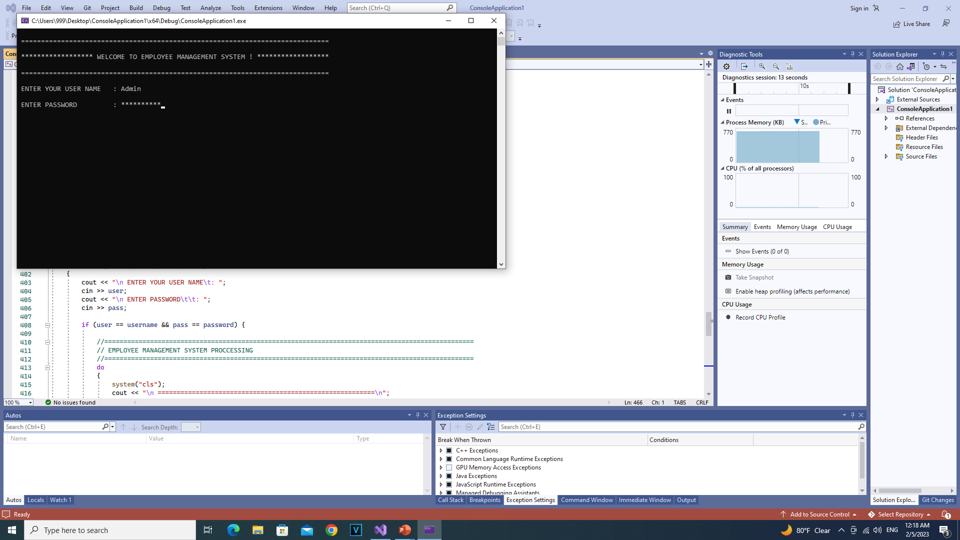
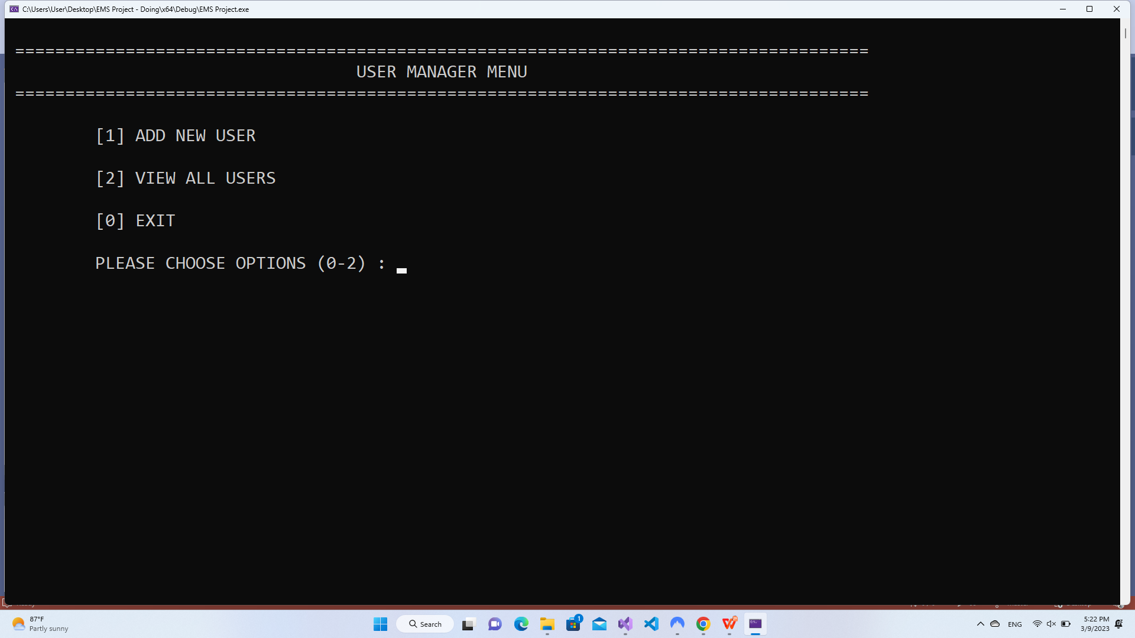
2.2 Physical Design User Interface
User Manager

Slide 8
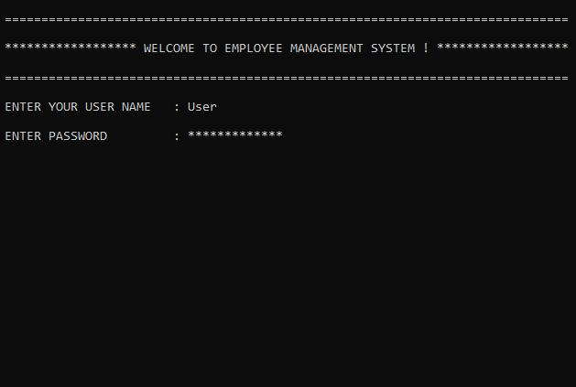
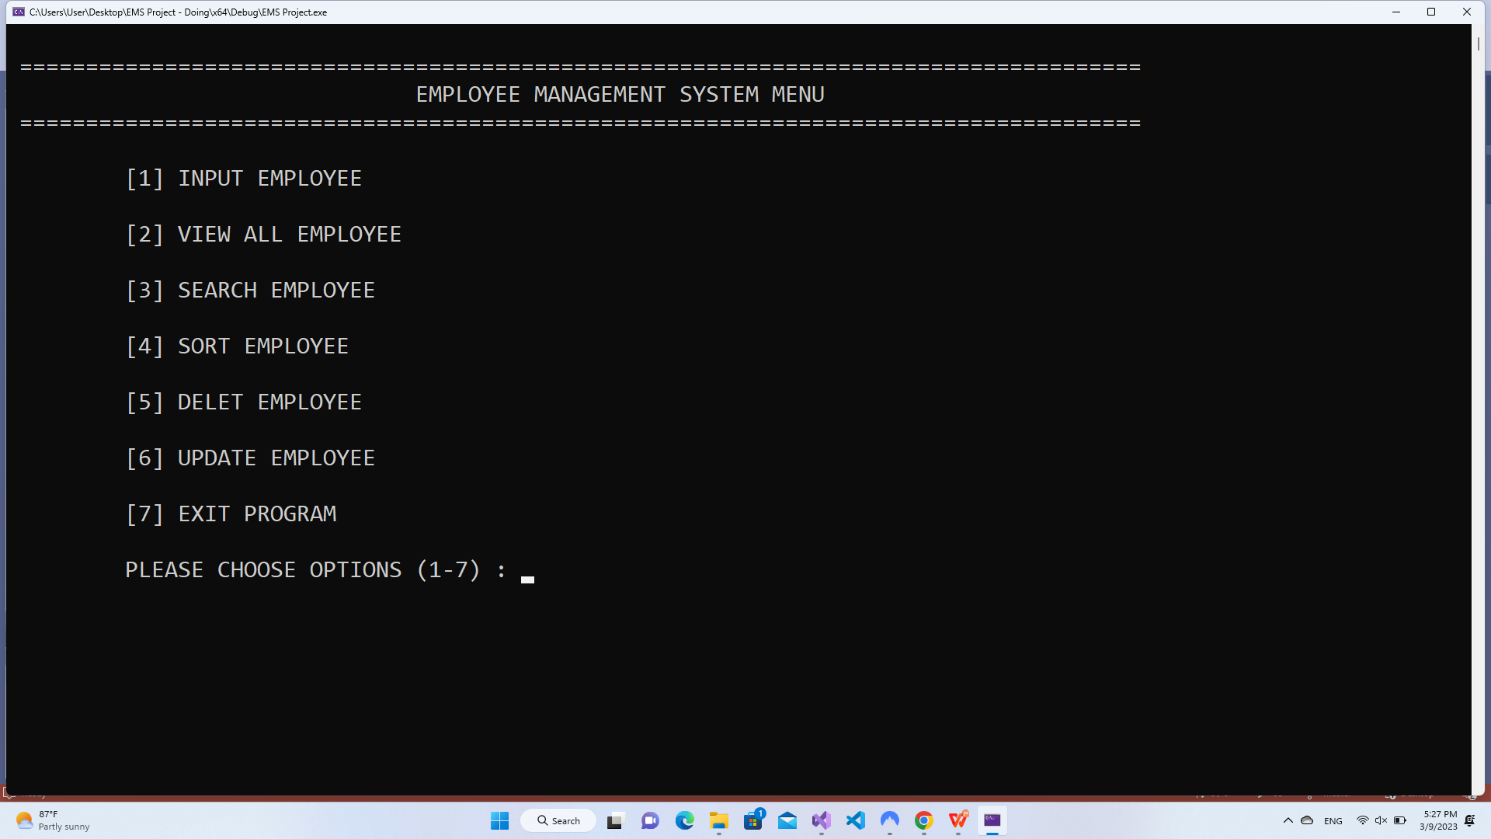
2.2 Physical Design User Interface
User

Slide 9
3. Coding and Debugging
OOP

Slide 10
4. Testing and deploying
Unit Testing

Slide 11
5. Upkeep and Maintenance

Slide 12
Thank You !

